Slide 1
CMZ Preliminary Recommendations
Community Information Sessions: February 2019

Slide 2
Agenda
Introductions
Reimagine RTS Process Update
Stage 2: Community Mobility Zone Consultant Recommendations
Stage 3: Paratransit Service
Next Steps
Summary
Stations Open for Discussion / Q&A

Slide 3
Why Reimagine RTS?
New technologies and mobility options are driving disruptive change in our industry.
People have more choices now. Transit needs to be more flexible to compete better with these new options.
Growing demands and investments in the community have outpaced investments in transit.
This has placed added stress on the transit system, making it critical for RTS to focus service investments where transit can be both effective and efficient.

Slide 4
Stage 1: Frequent Fixed Routes (For the Mass Transit Network)

Slide 5
Reimagine RTS Stages 2 - 5

Slide 6
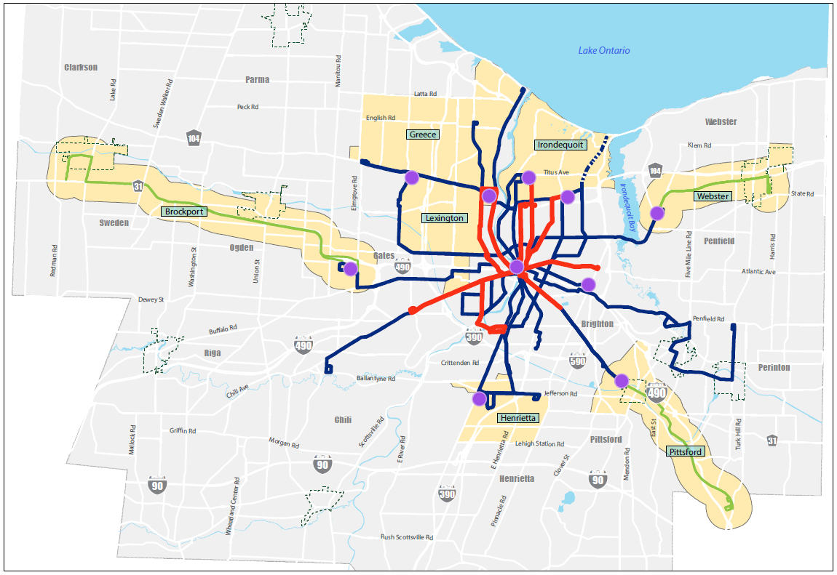
Community Mobility Zones

Slide 7
Stage 2: Community Mobility Zone Consultant Recommendations

Slide 8
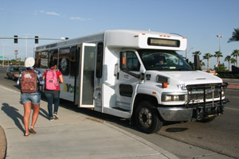
RTS Flex Route Service
What is it?
Small bus or van follows a consistent route with dedicated bus stops.
The vehicle will flex/deviate from the route to destinations within ¾ mile of the route
Operated by RTS w/ ADA accessible vehicles
Similar to how RTS operates outside Monroe County
Why it is Recommended for RTS?
Flex route service provides improved access and flexibility
Closer to curb-to-curb service for the customer
More appropriate vehicle size for number of customers in each area

Slide 9
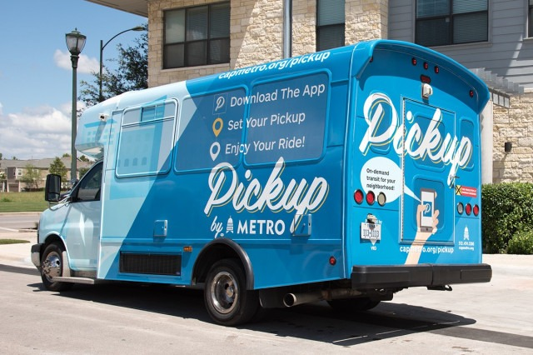
RTS On-Demand Service
What is it?
Small bus, van or sedan used to provide on-demand service within zone boundaries, when requested
Operated by RTS w/ ADA accessible vehicle
Why it is Recommended for RTS?
Curb-to-curb service provides improved access and near real-time travel
Makes it easier to reach destinations in the zone while providing easy access to the larger bus system

Slide 10
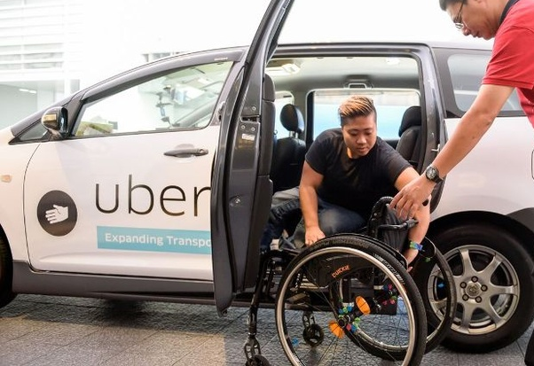
Personal Mobility on Demand (PMOD)
What is it?
Provides on-demand, door-to-door transportation for individuals or small groups
Service provided by a third-party (TNC, taxi, etc.)
Fare can include fixed price and/or maximum RTS subsidy per ride
Why it is Recommended for RTS?
Offers reliable transportation option in CMZs when RTS service is not running
On-demand, curb-to-curb service provides access to transportation when needed during low-demand times of the day
Provides expanded access to CMZ destinations and the larger bus system on weekdays and weekends
Notes:
How important is it that we include this as part of the final recommendation?
It is an option we are considering?

Slide 11
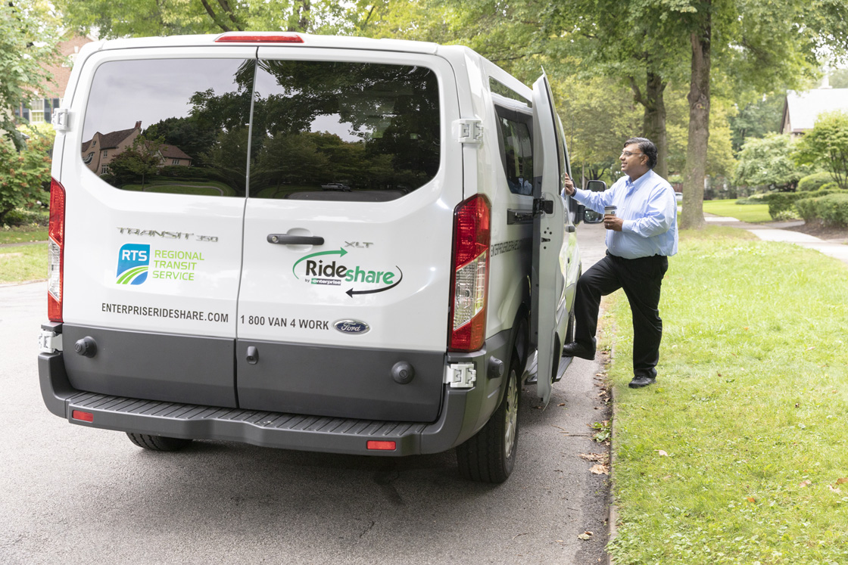
RTS-Enterprise Rideshare Vanpool Program
What is it?
Several individuals commute together to and from similar geographic locations in a van or SUV
Driving responsibilities shared by commuters, rotating daily or weekly
No cost or liability for employers
Currently offered by RTS through Enterprise Rideshare (myRTS.com/Vanpool)
Why does RTS offer it?
It offers alternative, reliable transportation where demand is low.

Slide 12
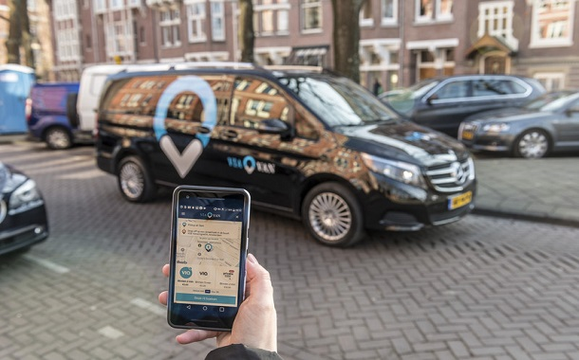
How to Get a Ride in CMZs
Customers will have multiple options to book their trips:
Call the RTS Customer Service Center
Online at myRTS.com
The RTS Mobile App
Mobile ticketing technology expected to launch in 2020

Slide 13
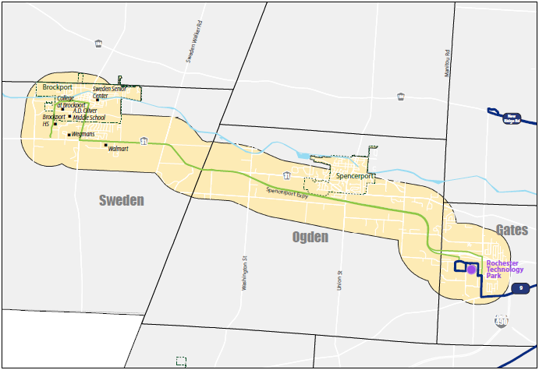
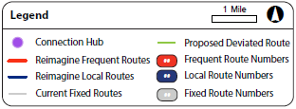
Brockport CMZ Consultant Recommendation
Proposed Solutions:
RTS Flex Route Service
Operated by RTS
M-F: 6am – 10pm
S-S: 6am – 7pm
Every 90 Minutes
PMOD
Operated by 3rd party
M-F: 5-6am, 10pm – Midnight
S-S: 7pm – Midnight
Key Destinations:
College at Brockport
Village of Brockport
Village of Spencerport
Rochester Tech Park
Brockport High School
A.D. Oliver Middle School
Brockport Retail Corridors
Sweden Senior Center
Owens Rd. Apartments
Legend
1 Mile
Connection Hub
Proposed Deviated Routes
Reimagine Frequent Routes
Frequent Route Numbers
Reimagine Local Routes
Local Route Numbers
Current Fixed Routes
Fixed Route Numbers

Slide 14
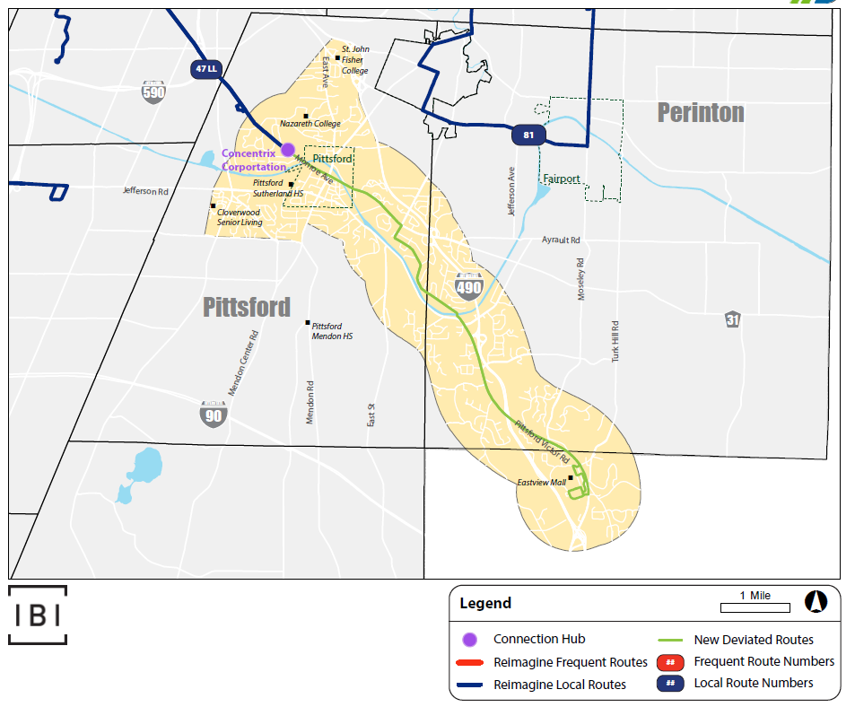
Pittsford/Eastview Area CMZ Consultant Recommendation
Proposed Solutions:
RTS Flex Route Service
Operated by RTS
M-Su: 6am – 7pm
Every 90 Minutes
PMOD
Operated by 3rd party
M-F: 5-6am, 7pm – Midnight
Sa-Su: 7pm – Midnight
Key Destinations:
Nazareth College
St. John Fisher College
Village of Pittsford
Cloverwood Senior Living
Eastview Mall/Retail Corridor
Pittsford Plaza
Pittsford Sutherland H.S.
The Highlands at Pittsford
YMCA
Eastview Mall Park & Ride

Slide 15
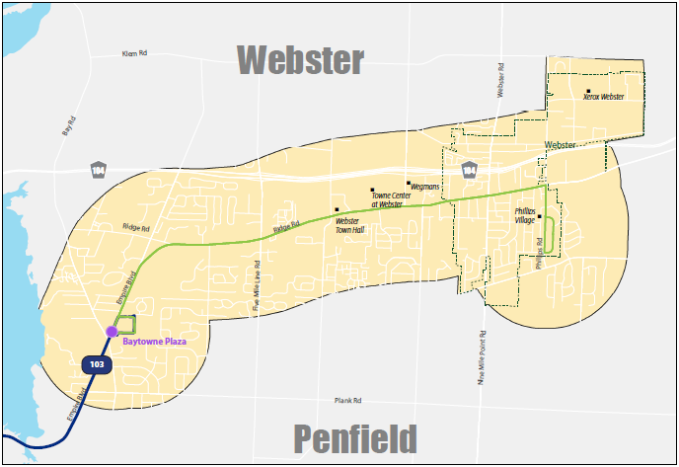
Webster CMZ Consultant Recommendation
Proposed Solutions:
RTS Flex Route Service
Operated by RTS
M-Su: 6am – 7pm
Every 90 Minutes
PMOD
Operated by 3rd party
M-F: 5-6am, 7pm – Midnight
Sa-Su: 7pm – Midnight
Key Destinations:
Ridge Rd. Retail & Service Corridor
Bay Towne Plaza
Town Center at Webster
Webster Town Hall
Phillips Village
Village of Webster
Legend
1 Mile
Connection Hub
New Deviated Routes
Reimagine Frequent Routes
Frequent Route Numbers
Reimagine Local Routes
Local Route Numbers

Slide 16
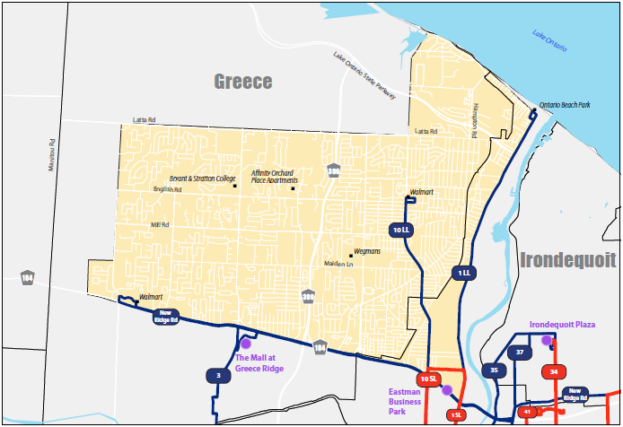
Greece CMZ Consultant Recommendation
Legend
1 Mile
Proposed Solutions:
RTS On-Demand Service
Operated by RTS
M-Su: 6am – 7pm
PMOD
Operated by 3rd party
M-F: 5-6am, 7pm – Midnight
S-S: 7pm – Midnight
Key Destinations:
The Mall at Greece Ridge
Ridge Road Retail Corridor
Latta Rd. Area / Wegmans
Walmart
Greece Town Hall & Library
Connection Hub
Reimagine Frequent Routes
Frequent Route Numbers
Reimagine Local Routes
Local Route Numbers

Slide 17
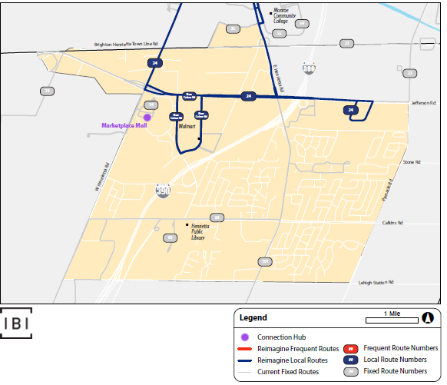
Henrietta CMZ Consultant Recommendation
Proposed Solutions:
RTS On-Demand Service
Operated by RTS
M-Su: 6am – 7pm
PMOD
Operated by 3rd party
M-F: 5-6am, 7pm – Midnight
S-S: 7pm – Midnight
Key Destinations:
Marketplace Mall / Henrietta Retail Core
Jefferson Rd. Corridor
Henrietta Town Hall Complex
MCC
Connections to RIT via RIT Shuttle
New VA Facility
Senior / Student / Affordable / Assisted Housing locations within CMZ

Slide 18
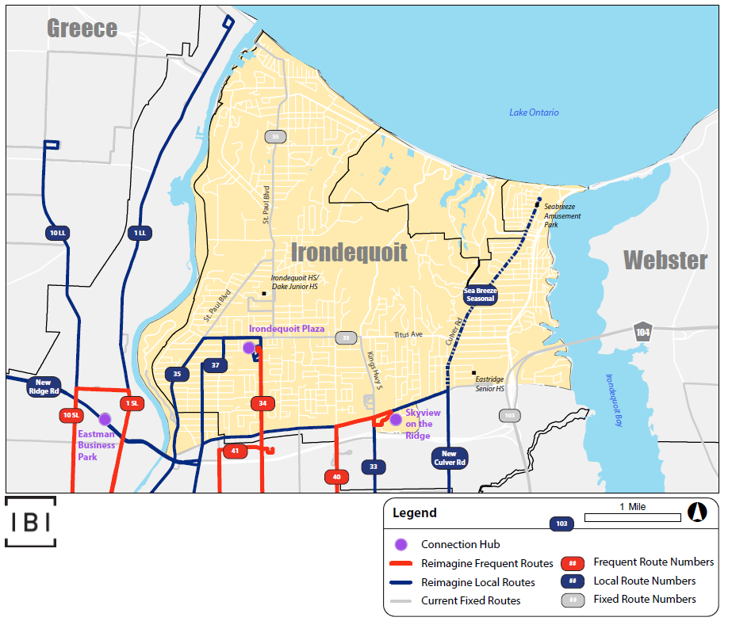
Irondequoit CMZ Consultant Recommendation
Proposed Solutions:
RTS On-Demand Service
Operated by RTS
M-Su: 6am – 7pm
PMOD
Operated by 3rd party
M-F: 5-6am, 7pm – Midnight
S-S: 7pm – Midnight
Key Destinations:
St. Ann’s Home
Skyview on the Ridge
Rochester Regional Health
Ridge/Titus Retail Corridors
Irondequoit Bay Park
Irondequoit H.S. / Hake M.S.
Seabreeze Amusement Park – to supplement seasonal route
Lakeshore Communities & Attractions

Slide 19
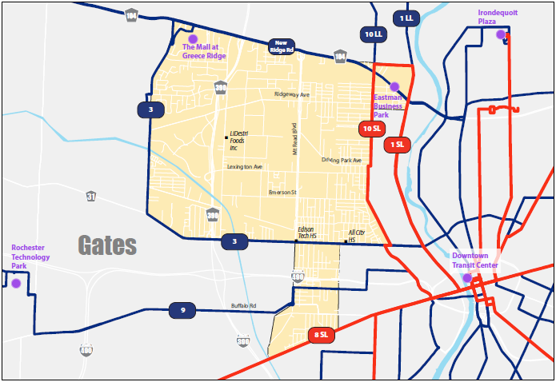
Lexington Avenue CMZ Consultant Recommendation
Proposed Solutions:
RTS On-Demand Service
Operated by RTS
M-F: 6am – 7pm
PMOD
Operated by 3rd party
M-F: 5-6am, 7pm – Midnight
Key Destinations:
Lexington Ave. Industrial Corridor
Eastman Business Park
Edison Career & Tech H.S.
Greece Ridge Mall
Current Fixed Routes
Reimagine Local Routes

Slide 20
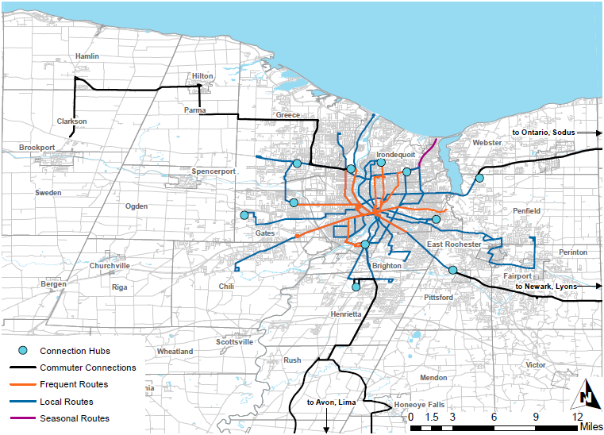
Commuter Connections
Proposed Solution:
2 round trips per day to each commuter destination
Connection Hubs
Commuter Connections
Frequent Routes
Local Routes
Seasonal Routes

Slide 21
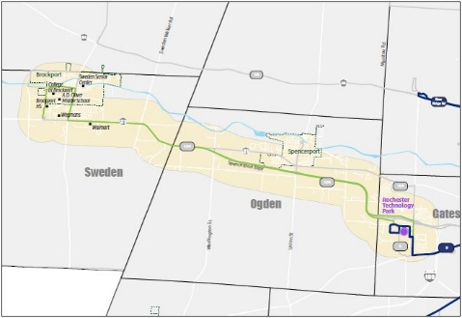
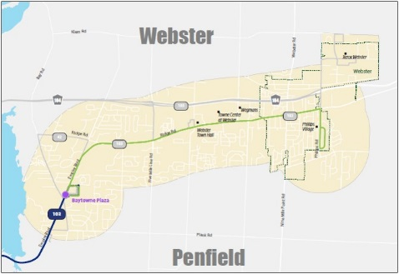
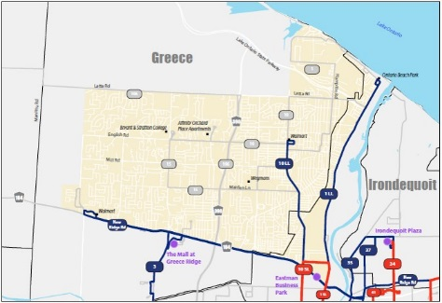
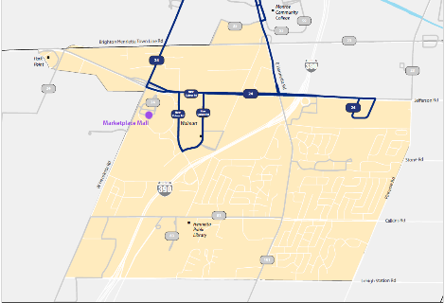
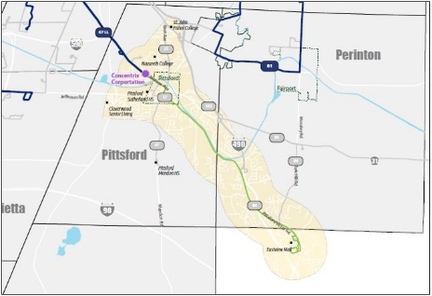
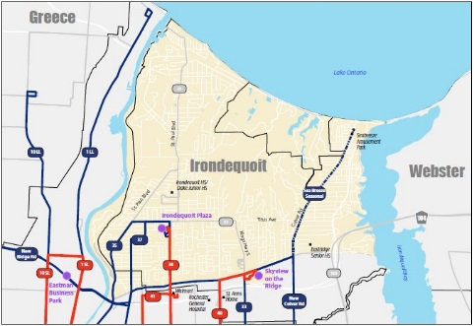
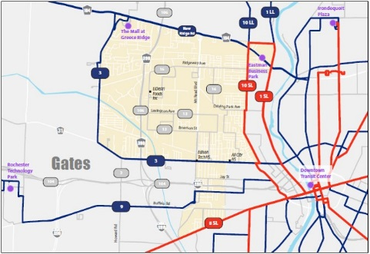
CMZ Service Discussion
Predominantly Linear
Dispersed, Many-to-Many
Brockport
Webster
Greece
Henrietta
Pittsford/Eastview
Irondequoit
Lexington Ave.

Slide 22
Stage 3: Paratransit Service

Slide 23
Discussion of Service Area Options
Because we receive federal funding, we must comply with ADA requirements as it relates to public transit services, including fixed route and route deviated services.
We currently provide a supplemental service area that expands our service beyond what the ADA requires for fixed route. We currently provide route deviated services in our seven regional counties, but not in Monroe County.

Slide 24
Current Paratransit Service Area (M-F)
RTS Access Service Area
Regular service area – ADA .75 miles
Suplemental service area – ADA 1.5 miles

Slide 25
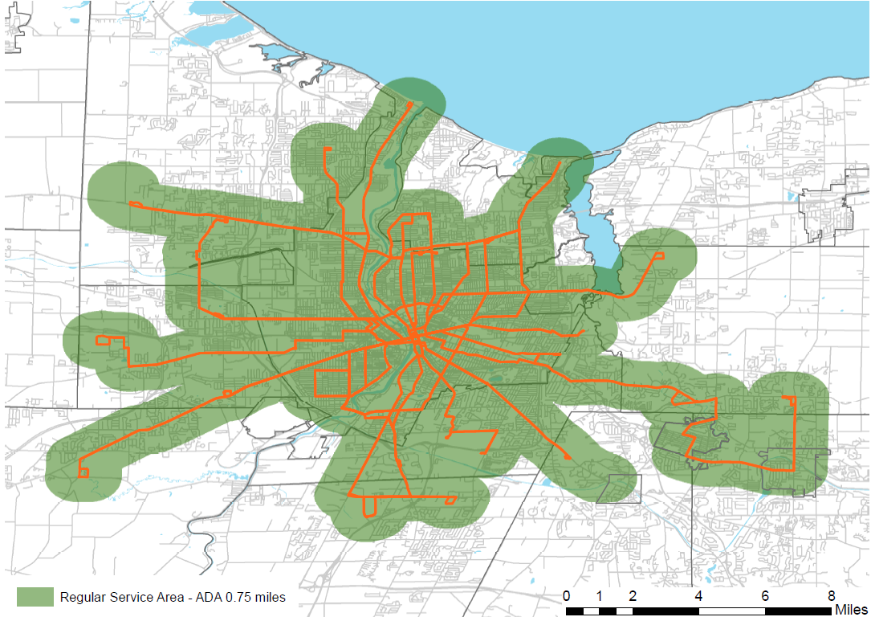
Service Area Requirement for New System
Regular service area – ADA .75 miles

Slide 26
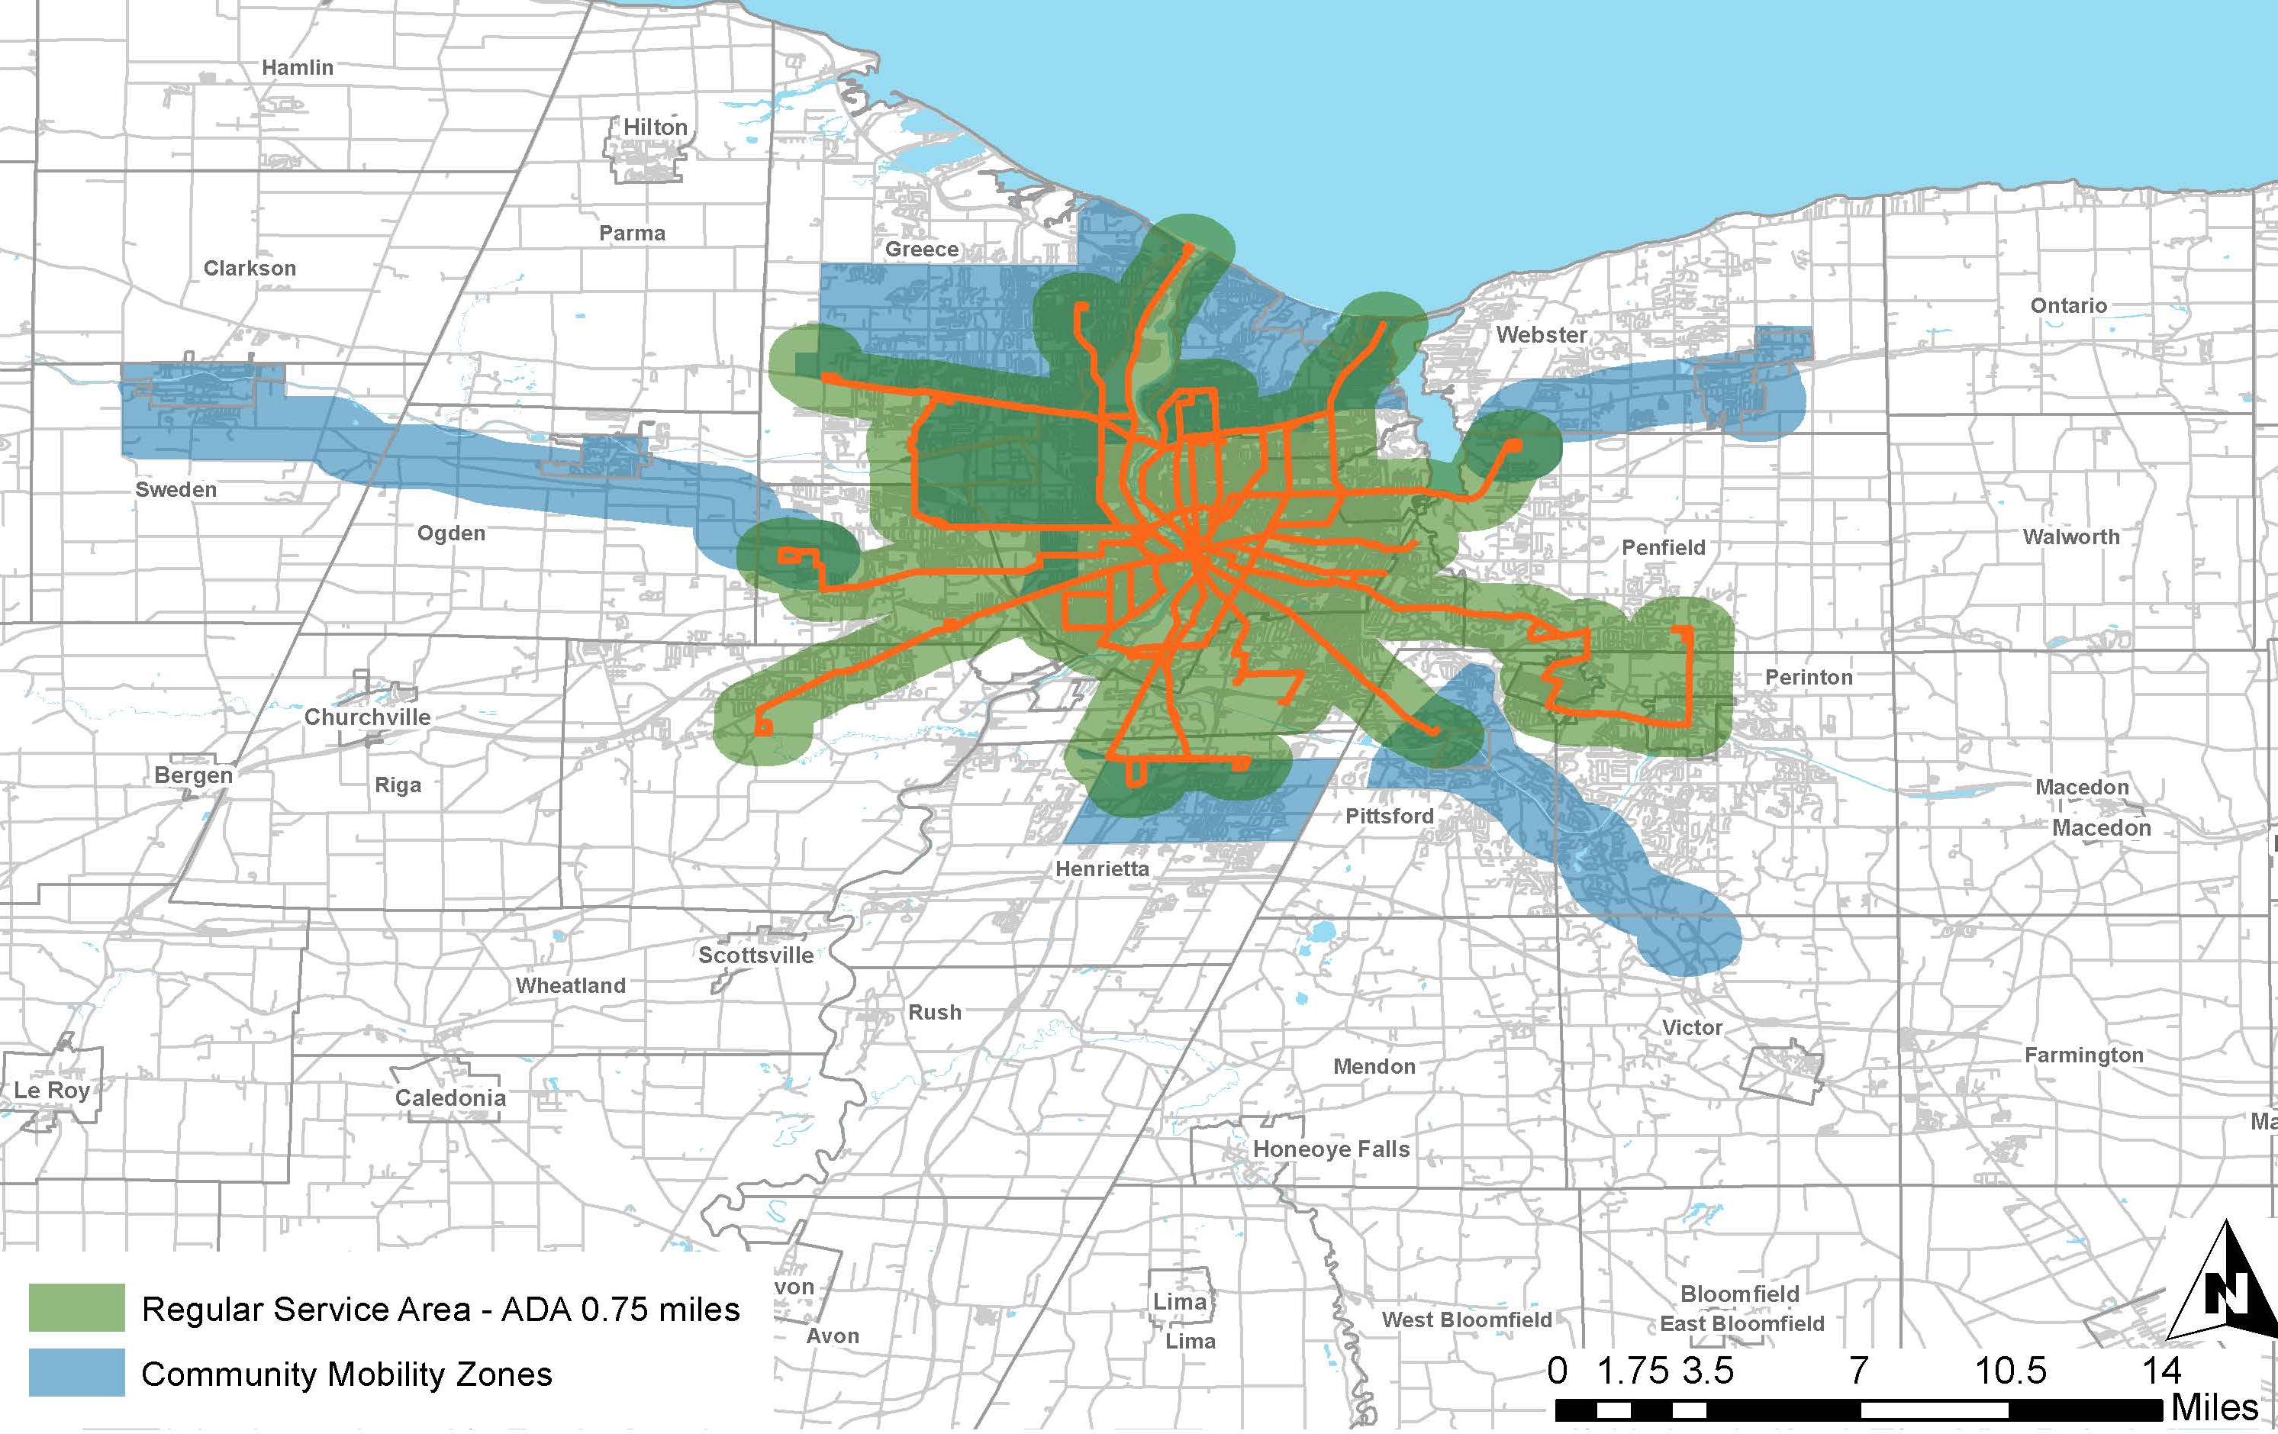
Side-By-Side Review
RTS Access Service Area
Regular service area – ADA .75 miles
Regular service area – ADA .75 miles
Supplemental service area – ADA 1.5 miles
Commuter Mobility Zones
Current Paratransit Service Area
Reimagine RTS Required Paratransit Service Area w/ CMZs

Slide 27
Paratransit Service Discussion
RTS Goal:
Ensure all existing paratransit trips are able to be completed
Options Being Considered to Achieve Goal:
Keep paratransit service area the same
Expand Reimagine RTS required paratransit service area
Make the CMZs the supplemental service area
Make the reimagined fixed and CMZ areas the required paratransit service area

Slide 28
Next Steps

Slide 29
Reimagine RTS Process

Slide 30
Summary

Slide 31
Benefits of New System
Reimagine RTS Goal: While it may be different, RTS wants all current customers to be able to access the new system.
RTS will provide consistent service 7 days/week.
New mobility options offer service in CMZs that is more reliable, frequent, and flexible.
On-demand service offers flexibility and means for spontaneous travel.
New System Offers Improved Accessibility:
Fare Payment: Mobile and traditional options
Trip Planning: Digital and traditional options
RTS will use ADA-compliant vehicles in CMZs

Slide 32
Stations Open: Discussion / Q&A

